Slide 1

Take five
Database series

Slide 2
Take five database series
Top Ten Tips for D205
Dr. William Sewell

Slide 3
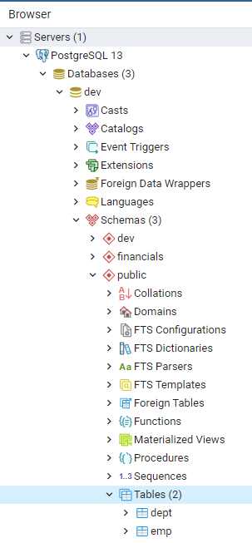
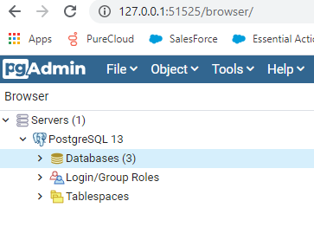
Connecting to a Database in PgAdmin

Slide 4
TOP TEN TIPS FOR D205 SQL FOR DATA ANALYTICS
Write a professional, graduate level paper. Provide a cover page, write a full paragraph for each item.
Be explicative. Include screenshots.
2. Proofread your work! Sometimes we think we wrote something a certain way but when we review it,
the wording isn’t what we meant to say.
Spell-check and grammar-check your work. Remember, if you make it easy on the Evaluator,
the Evaluator will make it easy on you!
Don’t overthink the assignment. For instance, you need only ONE research question. Keep it simple!
Enumerate your paper with what you are responding to in bold letters and numbers like A1.
Remember, if the Evaluator does not see it, it’s not there!

Slide 5
TOP TEN TIPS FOR D205 SQL FOR DATA ANALYTICS
6. Remember, if the Evaluator does not see it, it’s not there!
7. You will create a sixth table. Create the table, then import your data. Be sure when you create the
table that you have all the columns and their datatypes correctly written.
8. Check your work. Create a primary key. Be sure the table is included in your ERD.
Understand and explain your ERD. Say what referential integrity really means.
9. Be sure to include the SQL statement for items B2 and E.
10. Include at least two intext citations with matching references.

Slide 6
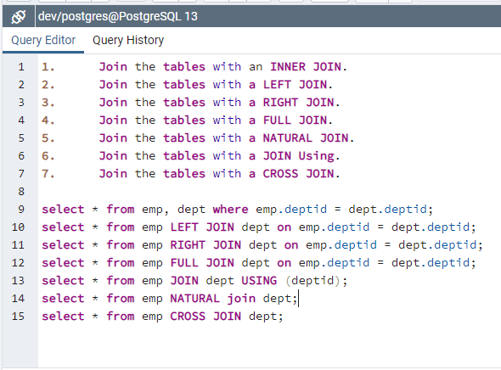
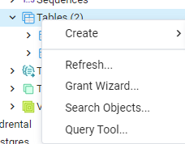
Select Query Tool by Right-clicking tables

Slide 7
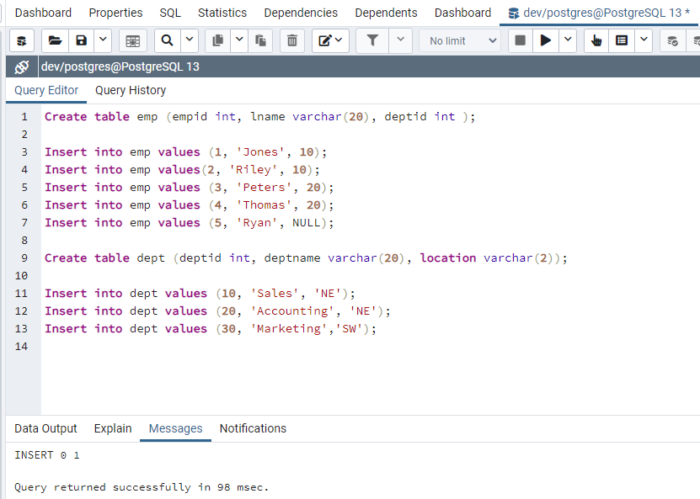
Creating tables and Inserting data in Postgres

Slide 8
Take five database series
Using psql on Windows
Dr. William Sewell

